Slide 1


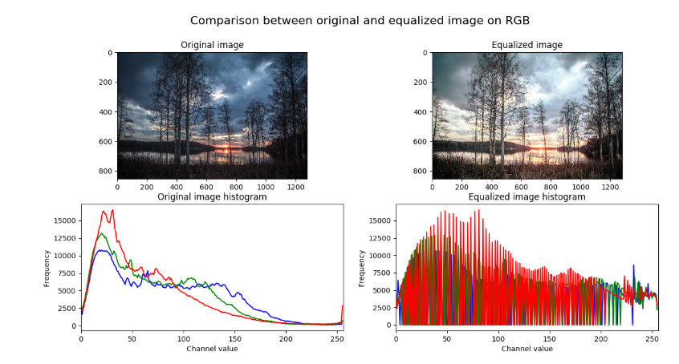

Session 7 :
Introduction to Histogram Analysis

Slide 2

Introduction
Histogram Analysis is used to study pixel intensity distributions.
It helps adjust image contrast, brightness, and color balance.

Slide 3
Learning Outcome
Understand how image histograms represent intensity distributions.
Learn to interpret and use histograms in image processing.

Slide 4
Programming Task
Task:
- Plot and analyze image histograms using OpenCV and Matplotlib.
- Work with both grayscale and color channels.

Slide 5
Why It Matters
Histograms provide insights into image quality.
Applications:
- Enhancing surveillance footage
- Adjusting photo lighting
- Dominant color analysis

Slide 6
Real-World Example
Scenario:
- Improving visibility in dark security footage
- Color balancing a poorly lit photograph

Slide 7
Skill Gained
Visual analysis of pixel distributions
Statistical reasoning for enhancement
Histogram plotting and interpretation

Slide 8
Understanding Image Histograms
Histograms reveal the spread and frequency of intensity levels.
Used to evaluate brightness, contrast, and exposure.

Slide 9
Plotting Histograms with Matplotlib
Use: cv2.calcHist() + plt.plot()
Visualize histograms for grayscale or RGB channels to assist image analysis.

Slide 10
Analyzing Histogram Peaks
Peak positions indicate dominant brightness levels.
Use for threshold decisions or contrast adjustments.

Slide 11
Comparing and Applying Histogram Insights
Use: cv2.compareHist to compare histograms across images.
Guide contrast stretching or threshold selection based on histogram analysis.

Slide 12
Python Code :
Histogram Analysis
Interactive Histogram Equalization and Analysis

Slide 13
Objective & Overview
Objective:
- Analyze and enhance image contrast using histograms
- Real-time control of histogram equalization
Overview:
- Load image and split BGR channels
- Compute and plot histograms
- Enable live equalization using a trackbar

Slide 14
Image Processing & Trackbar Setup
Image Loading:
- Read image using cv2.imread
- Split into B, G, R channels (cv2.split)
Trackbar Setup:
- Create OpenCV window
- Add 'Equalize' toggle using cv2.createTrackbar

Slide 15
Equalization & Histogram Plotting
Equalization Logic:
- If 'Equalize' is ON:
- Apply cv2.equalizeHist to each channel
- Merge channels with cv2.merge
- If OFF: use original image
Histogram Calculation:
- Use cv2.calcHist with 256 bins for each channel
- Plot histograms using Matplotlib subplots

Slide 16
Visualization & Exit Logic
Image Display:
- Show image (original or equalized) using cv2.imshow
- Update display in real-time
Loop Management:
- Use plt.pause to refresh histograms
- Exit loop with 'q' key
- Cleanup using cv2.destroyAllWindows and plt.close()

Slide 17

Python Script on Histogram Analysis
PART 1
import cv2
import numpy as np
import matplotlib.pyplot as plt
def nothing(x):
pass
# Load image
image = cv2.imread("pic.jpg")
if image is None:
raise ValueError("Image not found!")
cv2.namedWindow('Image')
cv2.createTrackbar('Equalize', 'Image', 0, 1, nothing)
plt.ion() # Interactive mode for real-time plots
fig, axs = plt.subplots(1, 3, figsize=(10, 3))
fig.suptitle('Color Channel Histograms')

Slide 18
PART 2
while True:
key = cv2.waitKey(100) & 0xFF
if key == ord('q'):
break
equalize = cv2.getTrackbarPos('Equalize', 'Image')
# Split channels
b, g, r = cv2.split(image)
if equalize == 1:
b_eq = cv2.equalizeHist(b)
g_eq = cv2.equalizeHist(g)
r_eq = cv2.equalizeHist(r)
display_img = cv2.merge((b_eq, g_eq, r_eq))
hist_b = cv2.calcHist([b_eq], [0], None, [256], [0, 256])
hist_g = cv2.calcHist([g_eq], [0], None, [256], [0, 256])
hist_r = cv2.calcHist([r_eq], [0], None, [256], [0, 256])

Slide 19
PART 3
else:
display_img = image
hist_b = cv2.calcHist([b], [0], None, [256], [0, 256])
hist_g = cv2.calcHist([g], [0], None, [256], [0, 256])
hist_r = cv2.calcHist([r], [0], None, [256], [0, 256])
# Show image
cv2.imshow('Image', display_img)
# Update histograms
axs[0].cla()
axs[0].plot(hist_b, color='blue')
axs[0].set_title('Blue')
axs[1].cla()
axs[1].plot(hist_g, color='green')
axs[1].set_title('Green')

Slide 20
PART 4
axs[2].cla()
axs[2].plot(hist_r, color='red')
axs[2].set_title('Red')
plt.pause(0.001)
plt.ioff()
plt.close()
cv2.destroyAllWindows()

Slide 21
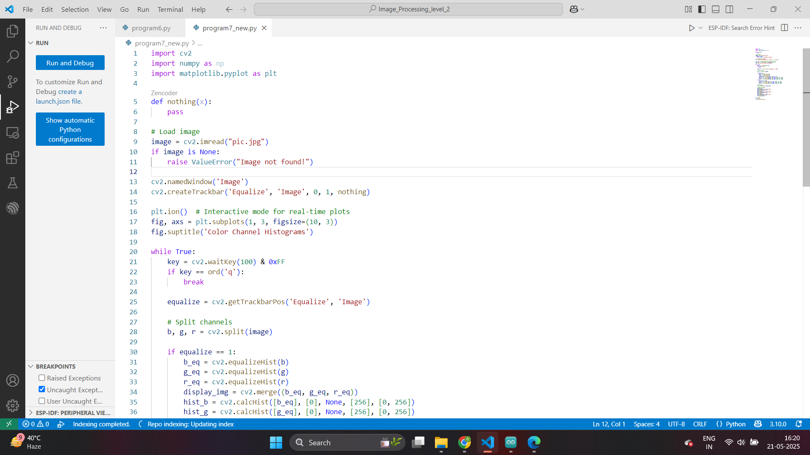

Slide 22
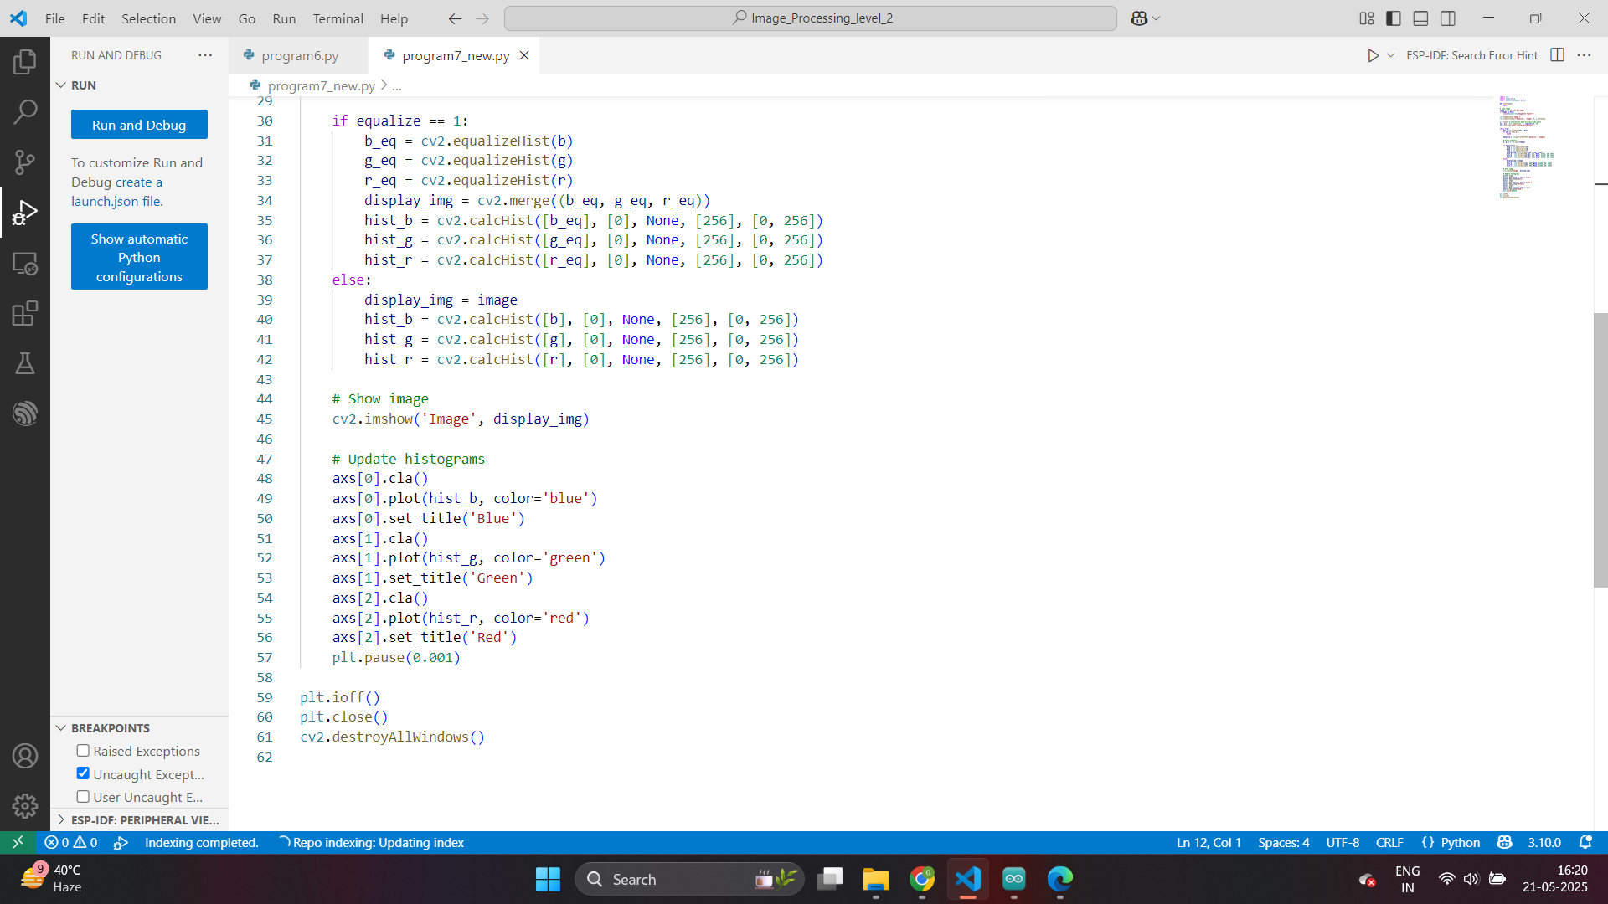

Slide 23
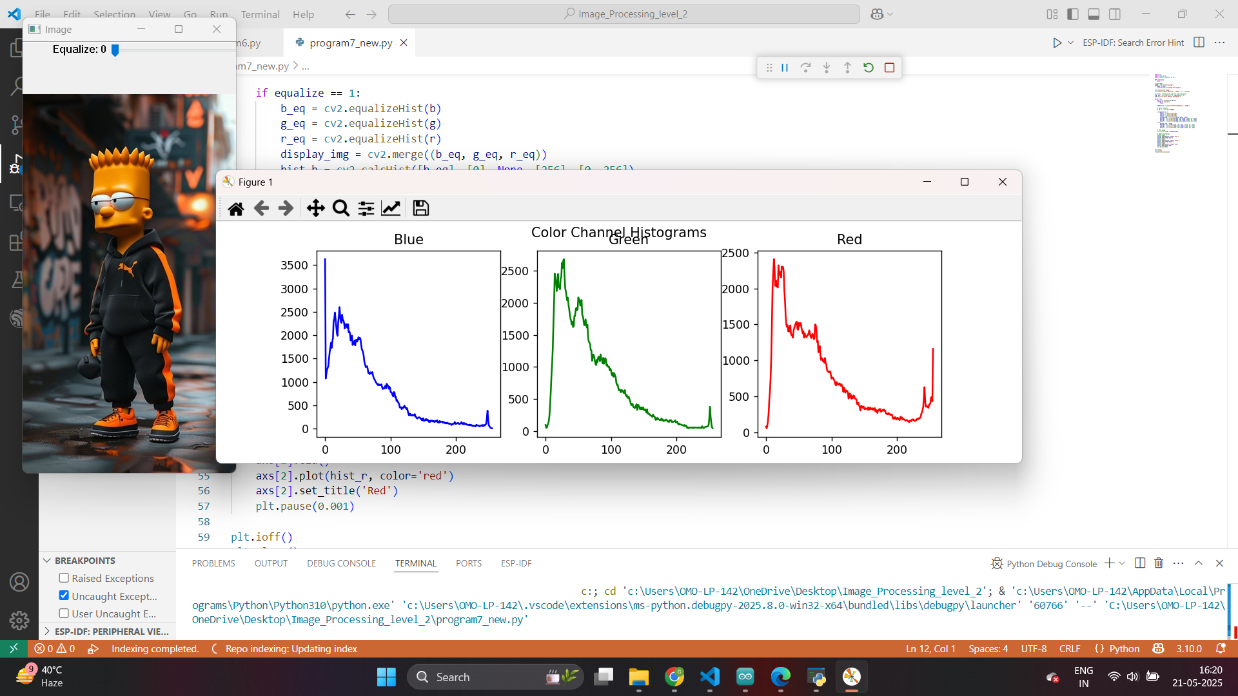

Slide 24
Exercise
1. What is the primary purpose of histogram analysis in image processing?
A) Noise reduction
B) Edge detection
C) Studying pixel intensity distribution
D) Adding filters
Answer: C
2. Which function in OpenCV is used to calculate histograms?
A) cv2.histogram()
B) cv2.calcHist()
C) cv2.plotHist()
D) cv2.analyzeHist()
Answer: B

Slide 25
Exercise
3. What does a histogram peak indicate in an image?
A) Number of objects
B) Dominant brightness levels
C) Edge sharpness
D) RGB balance
Answer: B
4. What is the function of cv2.equalizeHist() in histogram analysis?
A) Converts grayscale to color
B) Enhances image contrast
C) Removes background
D) Detects motion
Answer: B

Slide 26
Exercise
5. Which of the following can histogram analysis help improve?
A) Zoom quality
B) Audio output
C) Image brightness and contrast
D) Object detection
Answer: C
6. Which library is used alongside OpenCV for plotting histograms?
A) NumPy
B) TensorFlow
C) Matplotlib
D) Pandas
Answer: C

Slide 27
Exercise
7. What is used to split an image into B, G, R channels?
A) cv2.split()
B) cv2.divide()
C) cv2.separate()
D) cv2.colorSplit()
Answer: A
8. What is the purpose of using a trackbar in histogram analysis?
A) To load an image
B) To adjust equalization in real-time
C) To rotate the image
D) To save the image
Answer: B

Slide 28
Exercise
9. What kind of histograms can cv2.calcHist() generate?
A) Only for grayscale
B) Only for binary images
C) For grayscale and color channels
D) Only for RGB
Answer: C
10. What does cv2.compareHist() do in OpenCV?
A) Converts histograms to images
B) Merges histograms
C) Compares histograms of two images
D) Finds histogram peaks
Answer: C

